Slide 1
Service Oriented Architecture with Oracle

Slide 2
7 Steps to Achieving Business Agility with SOA

Slide 3


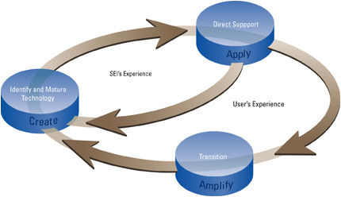
“Strategy to Execution” Gap
Customers /
Employees / Partners
IT Implementation
Cost
New Business Model
Time

Slide 4

















Existing IT Systems: Anchors to Change
Islands of information
  Fragmented data
Inflexible architecture
  Business process change takes years
~92% of IT budget spent on maintenance and integration and not innovation

Slide 5
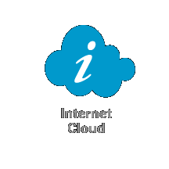



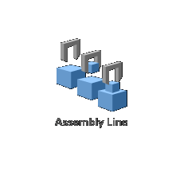
Exploiting Network Technology
Worldwide
Web
Service-Oriented Architecture
ERP
CRM
SCM
Custom
Networked
Information
Networked
Applications
Notes:
You know and understand the world wide web…
WWW gives you easy access to information anywhere (information access) With the WWW, You as a user connect to a web site.
A Service Oriented Architecture is a way to automate business process flows (process execution) With SOA, Applications or processes communicate with one another.

Slide 6
SOA: Business Agility Driven by a Responsive IT Infrastructure
Composite Applications
Oracle Fusion Middleware
“ With Oracle Fusion Middleware you can narrow the strategy to execution gap”
- BearingPoint
Development Framework
Unified Portal
Security & Management
Business
Process
Orchestration
Business
Activity
Monitoring
Business
Intelligence
Enterprise Service Bus & Registry
Existing IT Systems
Oracle Applications
SAP
Legacy
E-Business Suite
PeopleSoft
Siebel
iFlex

Slide 7

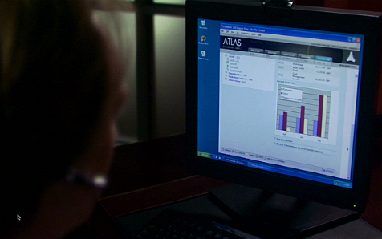
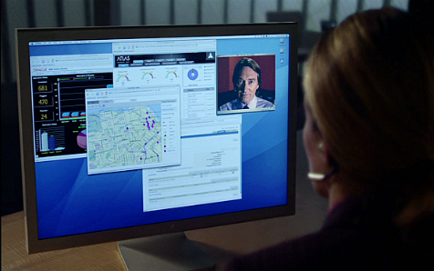
Service: Common Language between Business and IT
Collections
Service
Repository
Siebel CRM
Invoicing & Receivables
Customer Order Entry
Shipping (UPS)
Vendor Managed Inventory
Marketing
Peoplesoft HRMS
Customer
Division
Supplier
Outsourced
Shared
Service
Oracle Financials

Slide 8
SOA Impact on Application Development and Maintenance
Traditional Approach
Cumulative Cost
SOA
Infrastructure Investment
Develop New Applications
Leverage Existing IT Assets
Source: Forrester Research

Slide 9



Real-life SOA Adoption
Mainframe Migration,
Reduce Time of Delivering Systems
Insurance
Telco
Agile Process Introduction,
Change Management
Financial
Services
Reduce Time of Delivering System
Phased Modernization

Slide 10
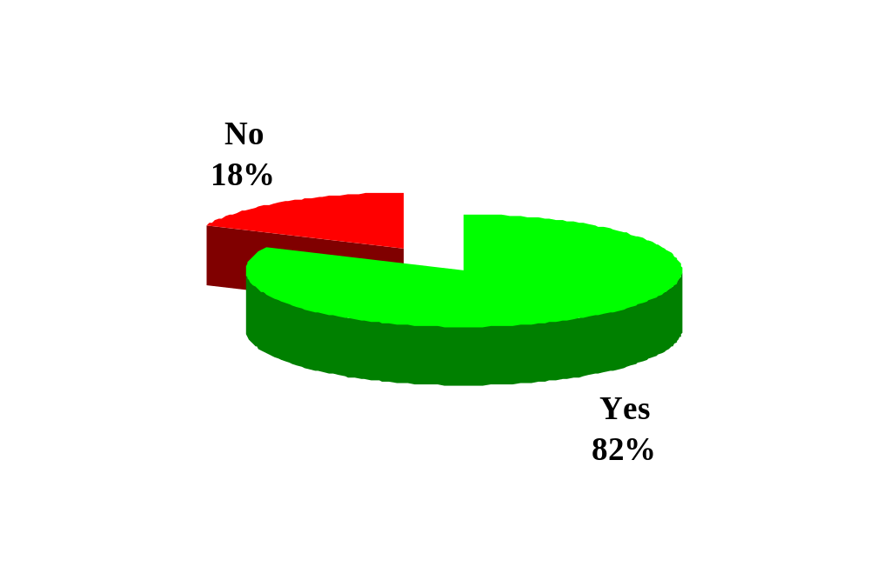
Majority of Companies View SOA as a Strategic Initiative
Is SOA a strategic initiative within your company?
Source: eBizQ Survey 2005, 200+ CIOs, CEOs, & IT Managers

Slide 11
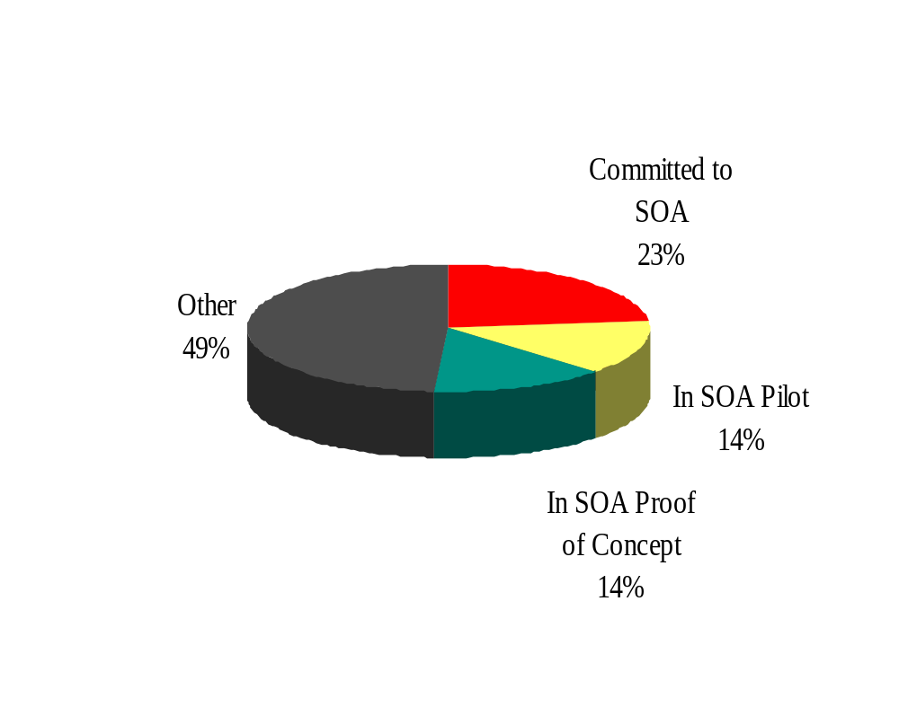
Majority of CIOs Pursuing SOA
Over 50% of respondents are actively pursuing SOA efforts
Source: eBizQ Survey 2005, 200+ CIOs, CEOs, & IT Managers

Slide 12
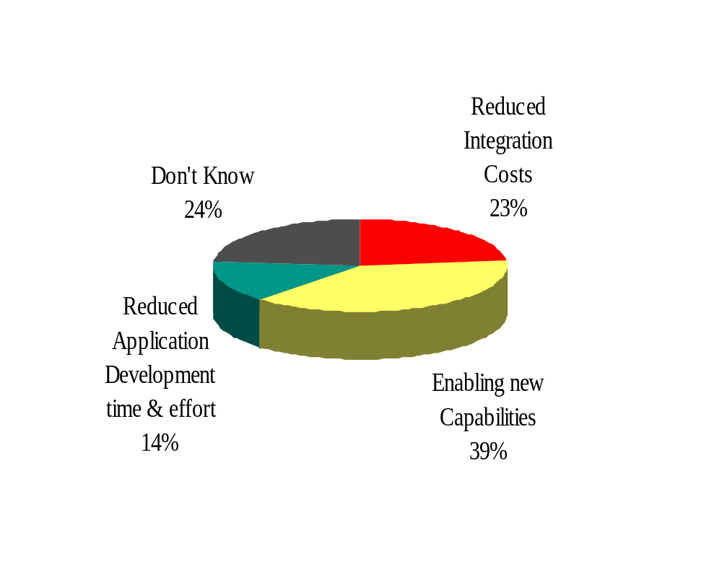
And Expect to Benefit in a Major Way
76% of respondents are expecting SOA to bring measurable benefits
Source: eBizQ Survey 2005, 200+ CIOs, CEOs, & IT Managers

Slide 13
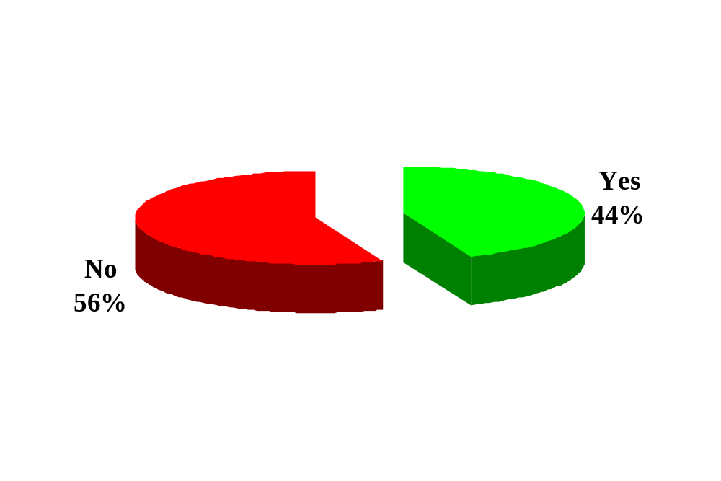
Majority of Companies Do Not Have a Well-defined SOA Strategy
Does your company have a well defined SOA strategy?
Source: eBizQ Survey 2005, 200+ CIOs, CEOs, & IT Managers

Slide 14
Issues to Consider for SOA
Strategy
&
Governance
SOA impacts and influences all business capabilities
SOA must be developed with a view towards the entirety of business capabilities
SOA must live in harmony with other architectures already in place
SOA
Strategy
Enterprise
Architecture
Business
Process
Acumen
Service
Availability
&
Security
Source: Accenture & Oracle

Slide 15
7 Steps to Adopting SOA

Slide 16

Step 0 | Select An Application
start
CRITERIA
Create
Expense
Report
Broken Process
Lack of Visibility
Variance
Integration Points
Clear Metrics
Human Task
Business Rules
?
Manager
Approval
Update
HR Module
DELIVERABLE
Automated Tasks
Process Sketch
Set of Human Tasks
Set of Automated Tasks
Set of Business Events
Set of Business Rules
Notify
Employee
Business Event
Expense
Processed
end

Slide 17



The Path to a Successful SOA Project
Select
Application
Build
Service
Portfolio
Service
Bus
Business
Process
User
Interface
Scalability
Dashboard
Security

Slide 18
Step 1 | Build Portfolio of Services
BEST PRACTICES
Contract/Interface First
Coarse Grain Documents
Asynchronous Interactions
Undo/Cancel Operations
Versioning
WS-I, Wrapped Document Style
WSIF Binding to Java, JCA
Java
Database
IMS, CICS
SAP
Oracle, PSFT

Slide 19
Step 2 | Wire Through An Enterprise Service Bus
BEST PRACTICES
UDDI Registry
JCA Adapters
Integration with Policy Management Framework
Service Virtualization
Logical Naming
Differed, Reliable Delivery
(Configurable)
Enterprise Service Bus
Java
.NET, SAP, Mainframe, Oracle,
Retek, PeopleSoft, Siebel, etc

Slide 20
Step 3 | Orchestrate into End-to-End Processes
BEST PRACTICES
BPEL
XSLT Transformation
Human Workflow Service
Rules Service
Notification Service
Error Hospital Service
ESB Binding and Wiring
Tracing and Debugging
Iterative Development
Unit Testing
fx
BPEL
Workflow
Rules
Enterprise Service Bus
Java
.NET, SAP, Mainframe, Oracle,
Retek, PeopleSoft, Siebel, etc

Slide 21
Step 4 | Expose through Rich User Interfaces
Portal, JSF Applications, .NET, Microsoft Office
BEST PRACTICES
JSF
WSRP, JSR-168
fx
BPEL
Workflow
Rules
Enterprise Service Bus
Java
.NET, SAP, Mainframe, Oracle,
Retek, PeopleSoft, Siebel, etc

Slide 22
Step 5 | Deliver Real-time Dashboards
Portal, JSF Applications, .NET, Microsoft Office
BEST PRACTICES
KPI First
Sensors to Collect Events without Business Process Changes
Real-time Dashboard
Alert/Actions
(Fusion Effect)
fx
BPEL
Workflow
Rules
Enterprise Service Bus
Java
.NET, SAP, Mainframe, Oracle,
Retek, PeopleSoft, Siebel, etc

Slide 23
Step 6 | Secure Interactions
Portal, JSF Applications, .NET, Microsoft Office
BEST PRACTICES
WS-Policy, WS-Security
Change Policy without Changing Endpoint
Integrated with ESB
(Multi-binding Support)
Agent and Gateway Mode
Support for Java and .NET
fx
BPEL
Workflow
Rules
Enterprise Service Bus
Java
.NET, SAP, Mainframe, Oracle,
Retek, PeopleSoft, Siebel, etc

Slide 24
Step 7 | Scale On Demand
Portal, JSF Applications, .NET, Microsoft Office
BEST PRACTICES
Asynchronous Interactions
Support for Large XML Documents
Clustering-Friendly
JCA and Java Binding
Batch API
fx
BPEL
Workflow
Rules
Enterprise Service Bus
Java
.NET, SAP, Mainframe, Oracle,
Retek, PeopleSoft, Siebel, etc

Slide 25
The Path to a Successful SOA Project
Select
Application
Build
Service
Portfolio
Service
Bus
Business
Process
User
Interface
Scalability
Dashboard
Security

Slide 26

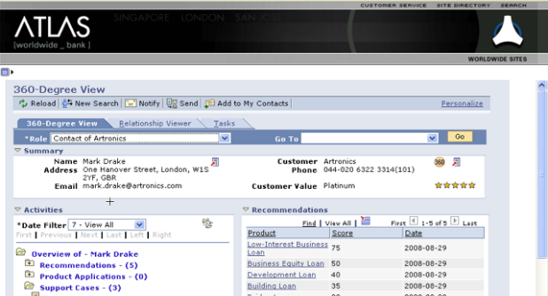

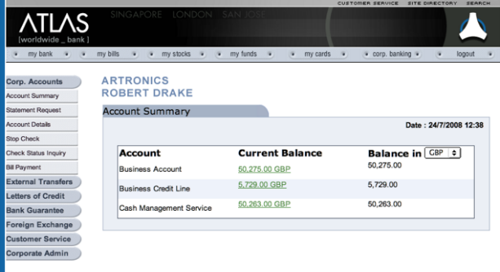

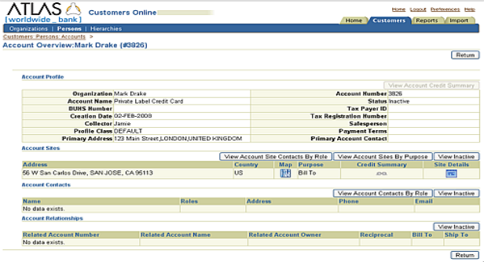
Internal Implementation
PeopleSoft
O
R
A
C
L
E
E
S
B
Oracle
BPEL PM
Siebel
E-Business Suite
Oracle
Data Hub

Slide 27
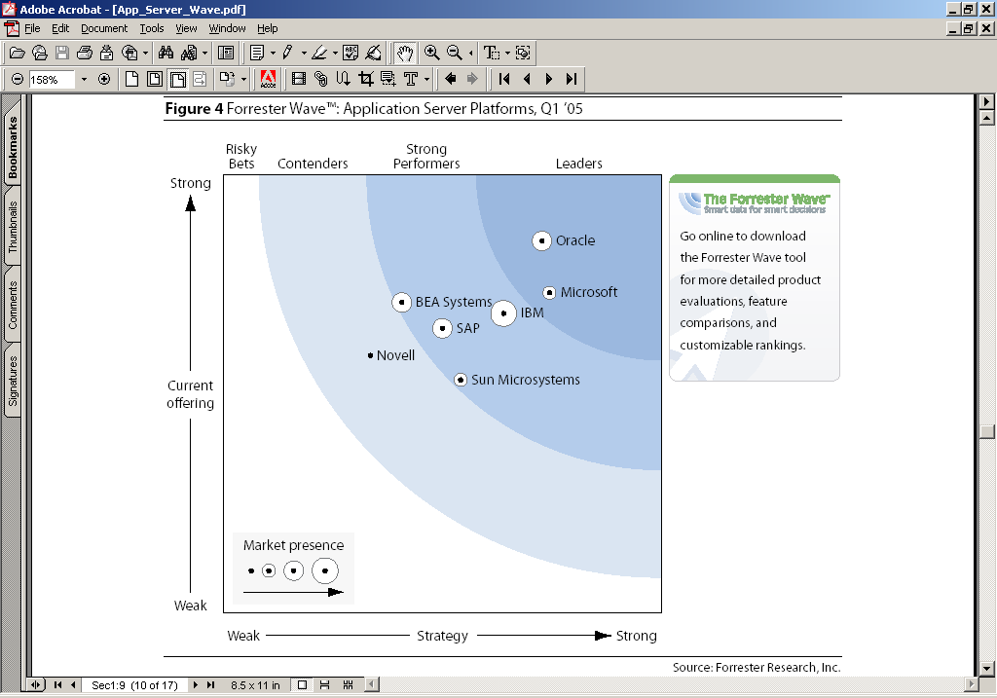

Middleware Suite Leader
Forrester Application Platform Wave, Q2 2005
“Oracle is the Leader”
“The Leading Composite App Development and Management Platform”
“We are Surprised by (the High) Degree of Integration between Components”
“Oracle Scored High Score on All Criteria”
Source: Forrester Research (April 2005)

Slide 28














SOA Customers
1,000+ customers world wide, Sample List
Source: Oracle.com

